Slide 1
Pick Your Plate
By: ^{The}A-Team
p.s. Jim V, David B, Andrea F, and Jonathan P

Slide 2











<technologies/>

Slide 3
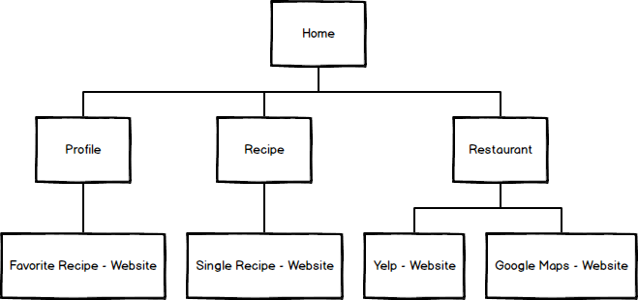
Site Map

Slide 4
DEMO TIME!!!

Slide 5
Question?

